Slide 1
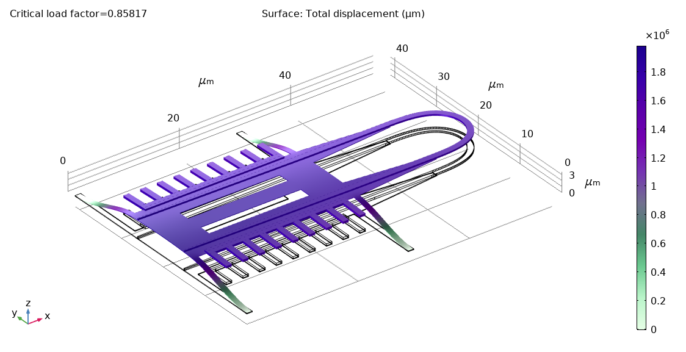
Optimization of Bistable Silicon Photonic MEMS Switch Architectures
Author : Claudio JARAMILLO
Supervisor : Dr. Hernán Furci
Responsible : Prof. Dr. Niels Quack
École Polytechnique Fédérale de Lausanne – Q Lab
June 2021

Slide 2
Contents
Introduction
Current implementation
Design & Development
Performance characteristics & Limitations
Conclusions

Slide 3
1. Introduction

Slide 4
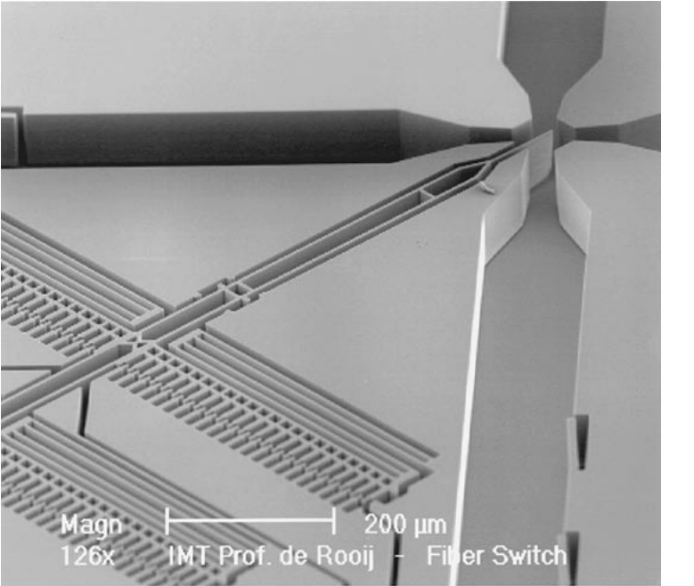
1. Introduction – Optical Switches
Optical switch : device that switches optical signals between channels.
Historically using mirrors.
MEMS are advantageous for their integration capabilities, reliability, and low power consumption.
Silicon photonic MEMS allows us to use well understood fabrication procedures.
Exploiting mechanical properties of MEMS, instability under buckling creates 2 stable states : we have created a latching switch.

Slide 5
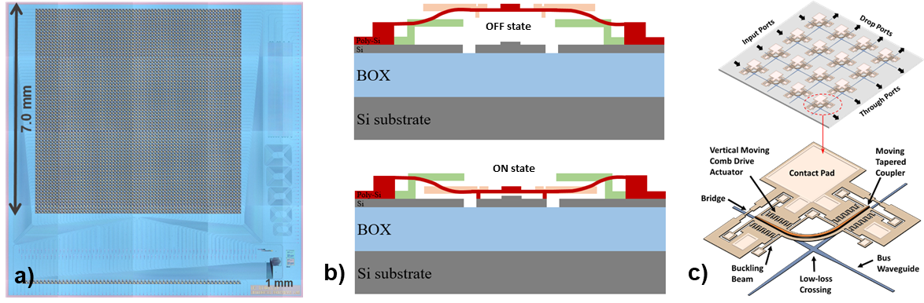
1.2 Introduction – Scope of the project
“Silicon Photonic MEMS Switches have recently been shown to be an excellent contender for large-scale photonic integrated circuit switch matrices.”
We want to design and simulate optimized silicon MEMS switch architectures.

Slide 6
2. Current implementation

Slide 7
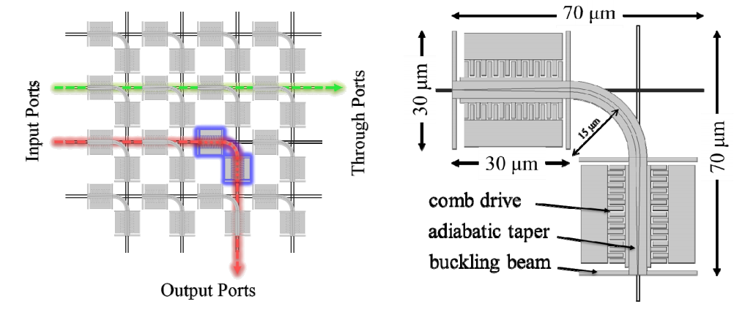
2.1 Current implementation – Original design
The original design exhibits bi-axial stress. Leads to instabilities, and torsion.
Footprint could be reduced.
Any design must maintain the same optical losses.
Low-loss crossing is untouched.
The matrix exists on 2 levels (top & bottom)

Slide 8
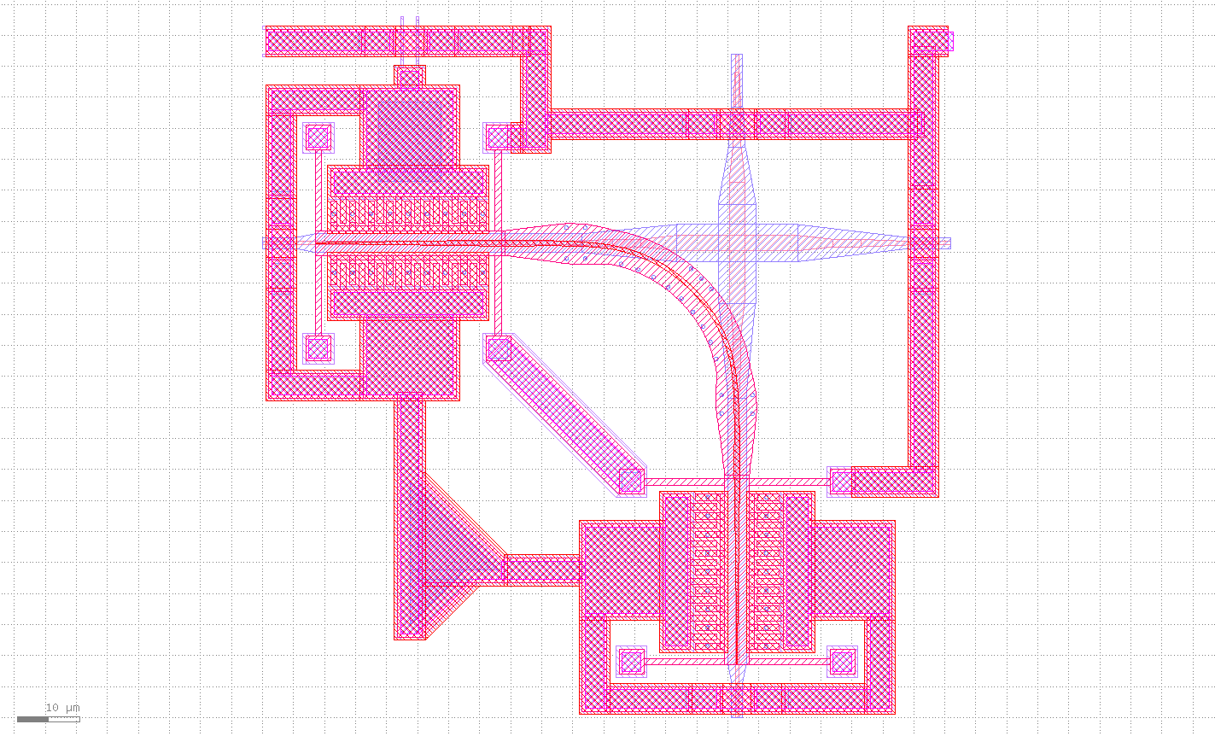
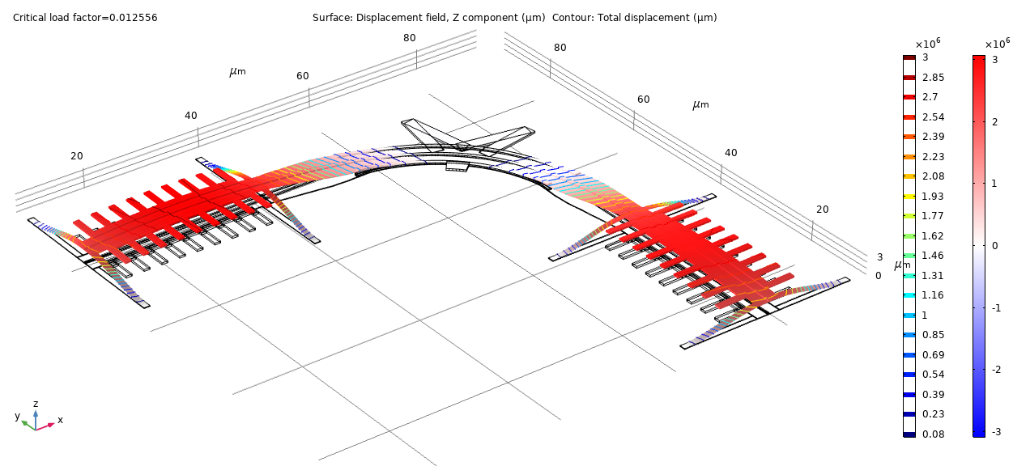
2.2 Current design – Optimization criteria
Uniaxial stress only.
Smaller footprint.
Increase switching speed.
Low losses.
(optional) all inputs (resp. outputs) on the same side.

Slide 9
3. Design and development

Slide 10
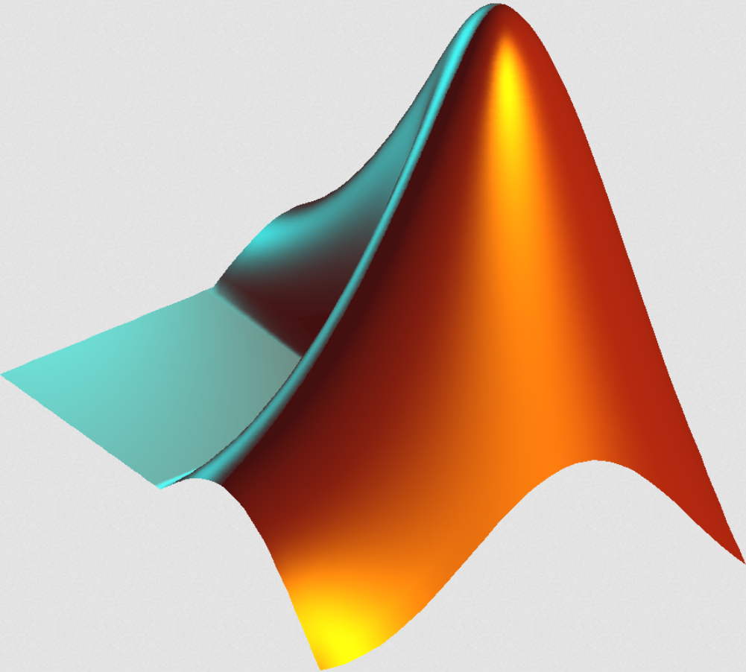
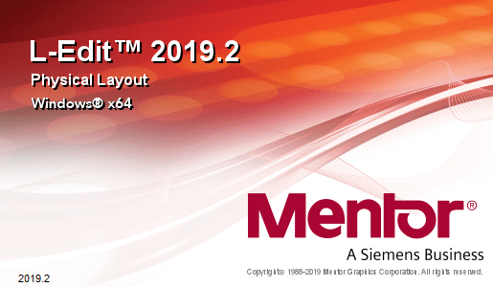


3.1 Design and development - Methodology
Geometry design on paper.
Implementation of specific elements using MATLAB.
Verification using KLayout & L-Edit.
Assembly on L-Edit.
Simulation on COMSOL.

Slide 11
Design 1 : Linear Coupler

Slide 12
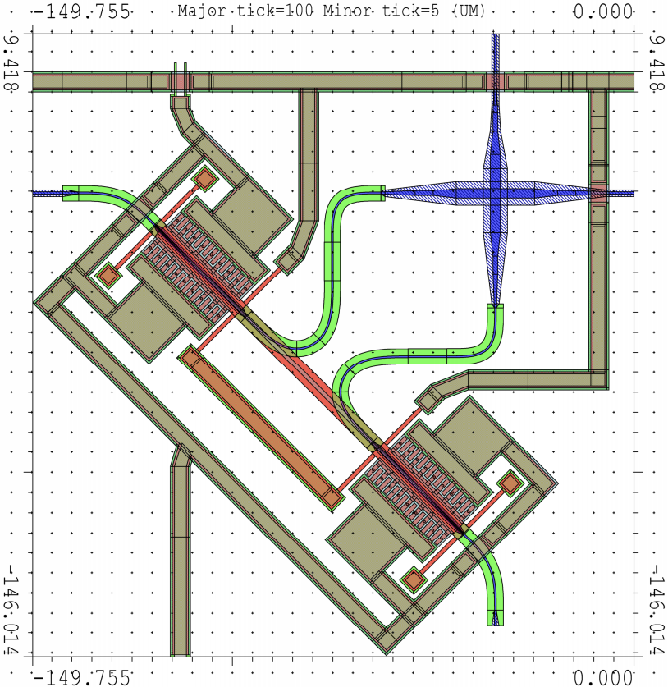
3.2 Design and development – Design 1
Coupler principle : linear clamped-clamped beam.
Bottom waveguide is deformed to comply with the geometry.
We use a Sine-Circle-Sine curve matching strategy.
Minimum radius of curvature is 5 um (strip). Curvature is continuous.
Estimated loss :
0.06 dB/cell (BWG)
0.48 dB/coupler

Slide 13
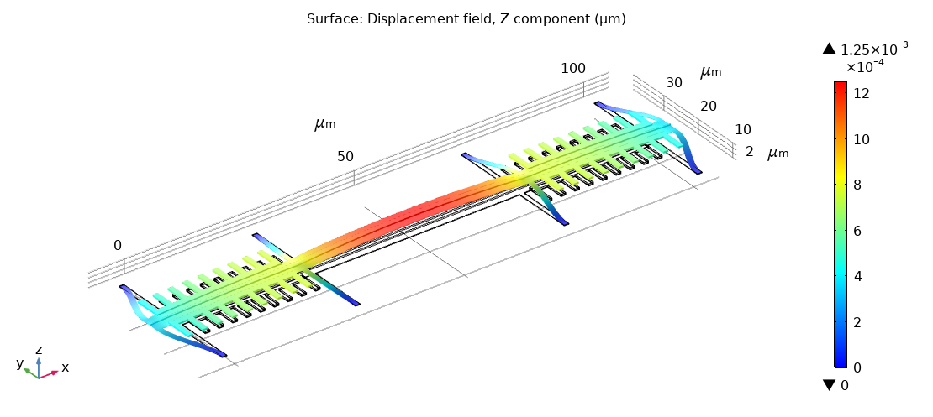
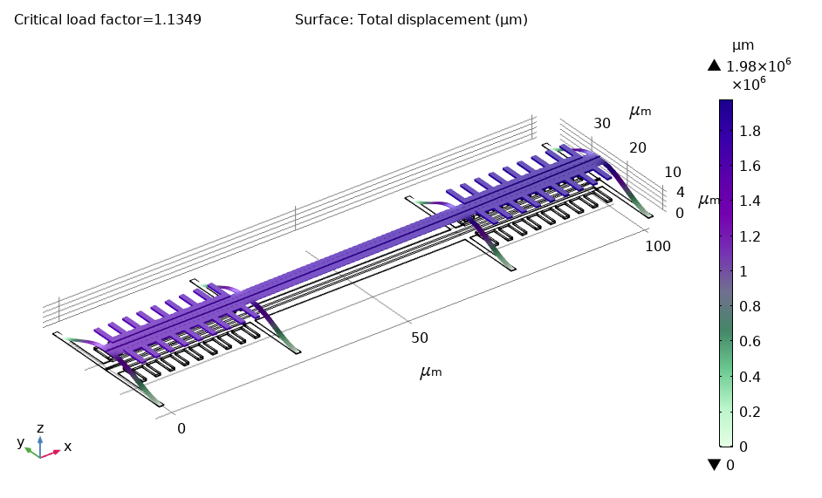
3.2 Design and development – Design 1 (cont’d)
Compressive stress of 7.78 MPa is applied. Load of 0.27 nN applied.
Upwards buckling at critical load factor of 𝜆=1.13.
Stationary deflection is too small, because the load is small (less than 1 nm).
First buckling mode, critical load factor = 1.13

Slide 14
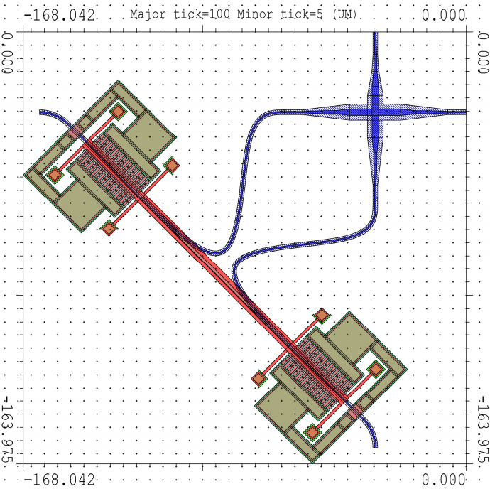
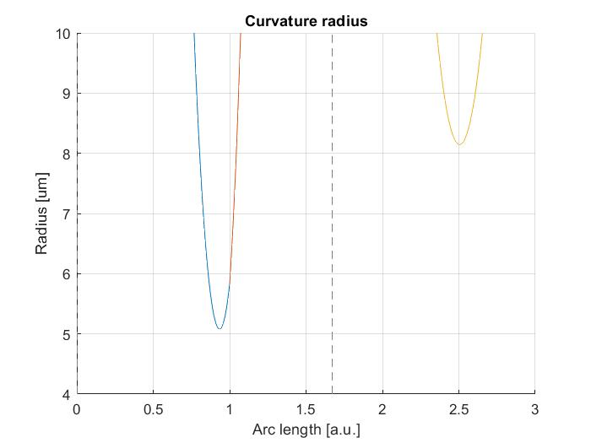
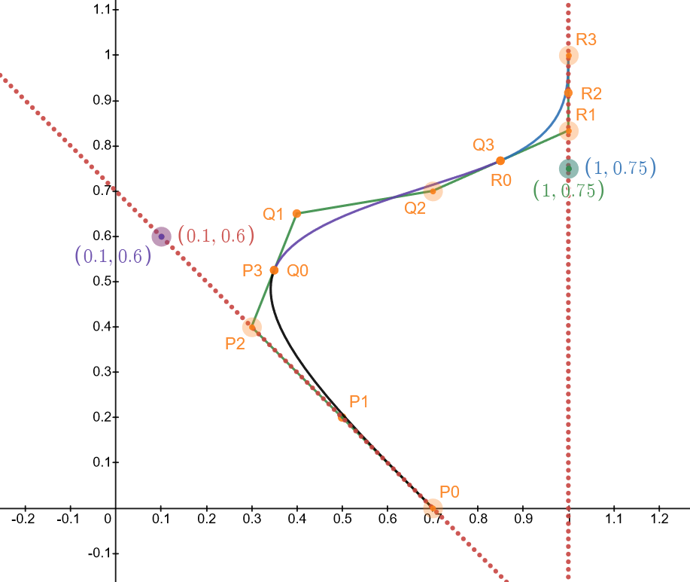
3.2 Design and development – Design 1 alternative
Using 3rd order Bézier curves
The design respects all constraints.
However the entire path should be rib waveguides.
Coupler length is higher.
Estimated loss : 0.05 dB/cell (BWG).

Slide 15
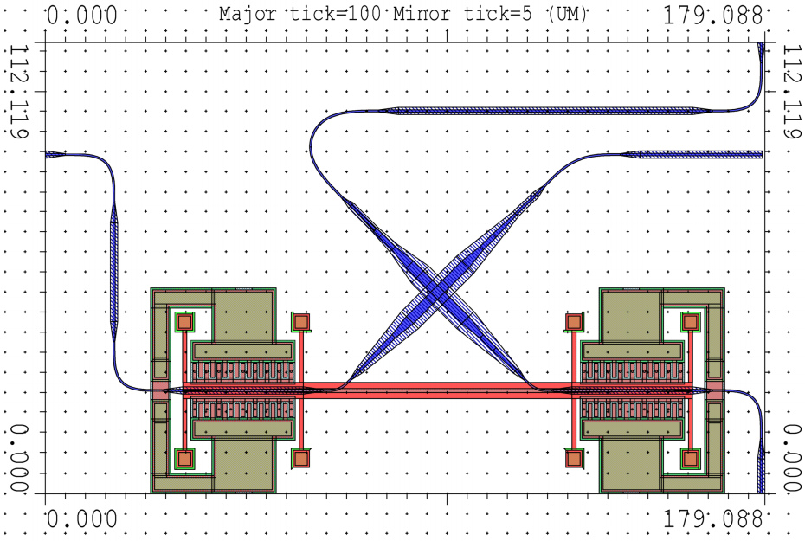
3.2 Design and development – Design 1 alternative (cont’d)
We attempt to reduce the overall footprint by changing the orientation of the low-loss crossing.
The coupler is pushed as close as possible to the crossing.
Main problem : high optical losses.
If we try to reduce the bends, we increase the footprint, and stagger the cells : bad design !

Slide 16
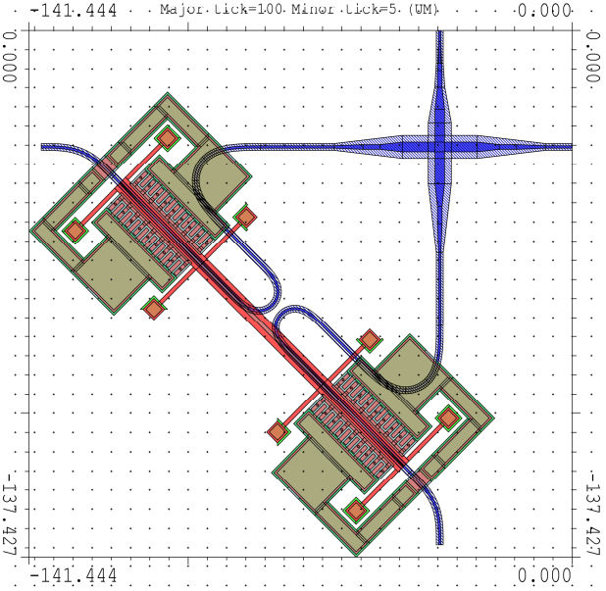
3.2 Design and development – Design 1 conclusions
Main limiting parameter is the crossing of both ‘’lobes’’ on the bottom waveguide. Pushing the drive closer to the low-loss crossing creates an overlap in the lobes.
A more compact design also interferes with the suspension and the row/column addressing.
3rd order Bézier curves provide an elegant solution to the problem.
Main problems : footprint of low loss crossing, optical losses.
Linear design with lobes pushed close together

Slide 17
Design 2 : U-Turn coupler

Slide 18
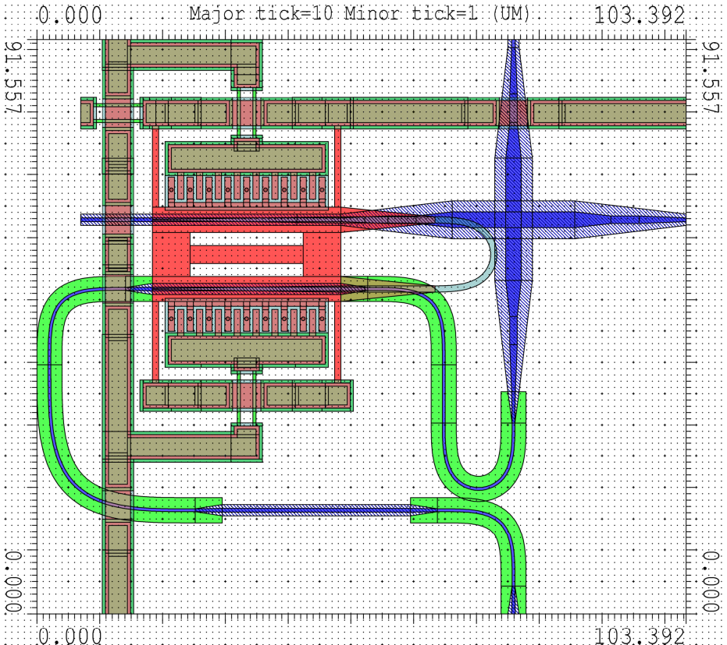
3.3 Design and development – Design 2
Coupler principle : suspended U-Turn.
Bottom waveguide is deformed using sine-circle sine methods.
MEMS redesigned.
Minimum radius of curvature is 5 um (strip).
Estimated loss :
0.13 dB/cell (BWG)
0.52 dB/coupler

Slide 19
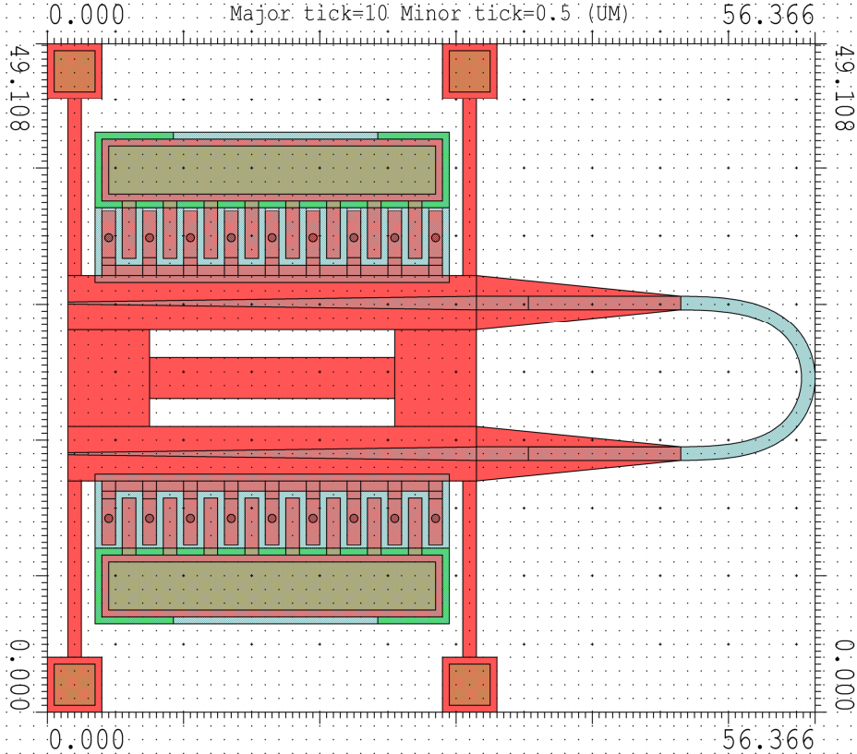
3.3 Design and development – Design 2 MEMS redesign
We remove 2 comb drive actuators and join both inlet-outlet together.
Beam in the middle acts as anti-roll bar.
The MEMS is already smaller than the crossing.
Further mechanical simulations could reduce the MEMS mass.
U-Turn coupler with smallest possible radius.

Slide 20
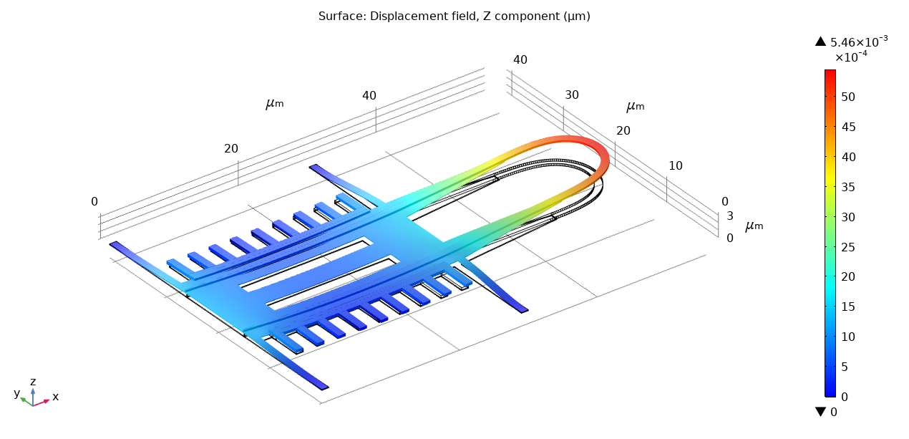
3.2 Design and development – Design 2 (cont’d)
Compressive stress of 7.78 MPa is applied. Load of 0.27 nN applied.
Upwards buckling at critical load factor of 𝜆=0.86.
Stationary deflection is too small.
Deflection of 150 nm achieved for approx. 100 times the initial load.
First buckling mode, critical load factor = 0.86

Slide 21
3.2 Design and development – Design 2 conclusions
The geometry is limited by the low-loss crossing.
We redesigned the comb drives.
Applied load is not sufficient to obtain the required deflection.
Buckling mode behaviour as expected.
Highly compact.
Main problem : high optical losses.

Slide 22
Design 3 : Sigmoid Coupler

Slide 23
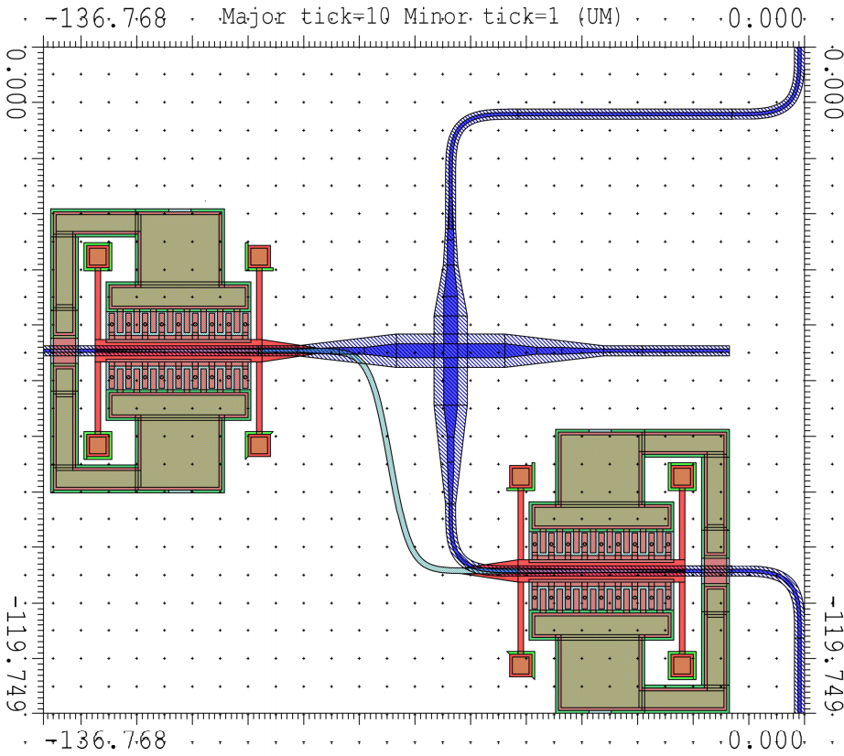
3.4 Design and development – Design 3
Coupler principle : suspended logistic sigmoid function.
Both waveguides are deformed using sine-circle sine methods.
Minimum radius of curvature is 5 um (strip), obtained via parametrization.
Estimated loss :
0.08 dB/cell (BWG)
0.54 dB/coupler

Slide 24
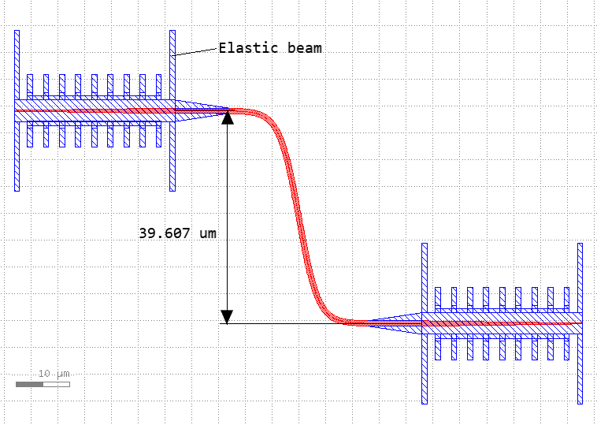
3.4 Design and development – Design 3 Coupler
The sigmoid height is limited by the low-loss crossing (again !).
A smaller coupler would require a redesign of the BWG : tight turns, high losses.
Mechanically compromised.
Sigmoid coupler with a height limited by the low-loss crossing.

Slide 25
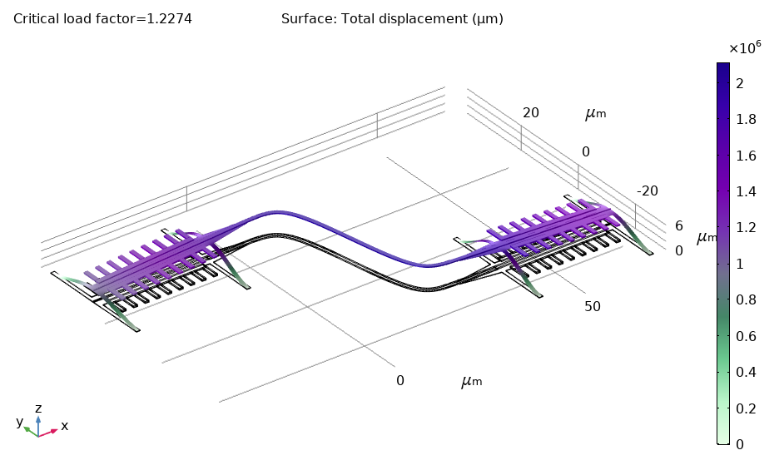
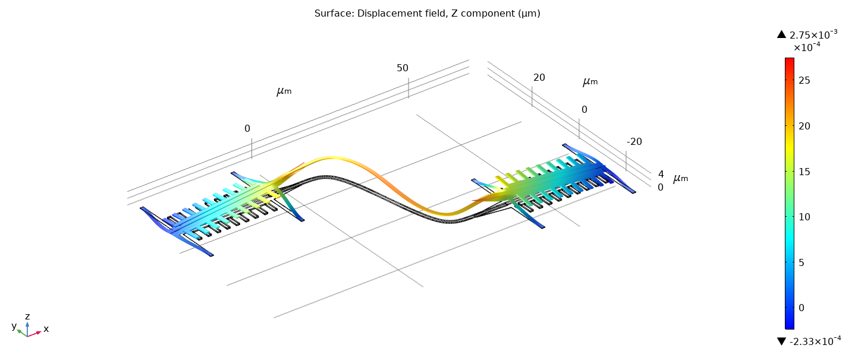
3.2 Design and development – Design 3 simulations
Compressive stress of 7.78 MPa is applied. Load of 0.27 nN applied.
Upwards buckling at critical load factor of 𝜆=1.23.
Stationary deflection shows that the design is mechanically unstable.
First buckling mode, critical load factor = 1.23

Slide 26
3.2 Design and development – Design 2 conclusions
Elegant solution because of the parametrization capabilities.
The geometry is limited by the low-loss crossing.
MEMS is thin and long, therefore mechanically unstable, as expected and demonstrated by the FEM simulation.
Design could be useful for a lower height (approx. 15 um).
Main problems : high footprint, mechanically unstable MEMS.

Slide 27
4. Performance characteristics & Limitations

Slide 28
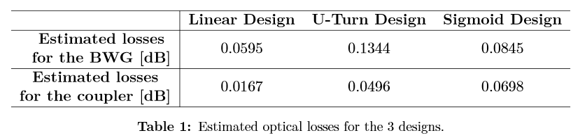
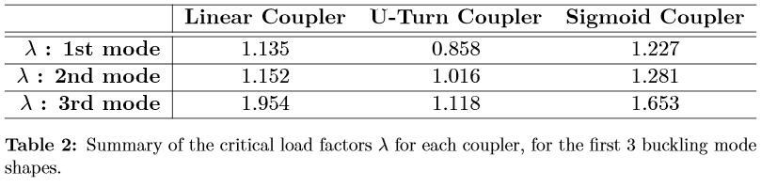
4.1 Performance characteristics – Summary

Slide 29
4.2 Limitations - Summary
Design size limitations
Performance limitations
Main limitation in the design is the low-loss crossing.
For all 3 designs it is the limiting factor.
But, the low-loss crossing cannot be miniaturized : current dimensions minimize cross-talk.
Main limitation in performance is the optical loss.
If BWG’s optical losses are in the range of the crossing, then the design is too lossy.
All designs show high losses because the BWG needs to accommodate small MEMS, and a big LLC.

Slide 30
5. Conclusions

Slide 31
5. Conclusions
The linear design as the lowest losses, and the simplest MEMS.
The U-Turn design has the smallest MEMS, the smallest footprint, but the highest losses.
It is important to keep in mind that the low-loss crossing is the limiting factor for all future work.
These designs could be used for other projects.
 | Pros | Cons
Linear design | Simple MEMS. Lowest optical losses. | Larger footprint.
U-Turn design | Most compact design. Smallest MEMS. | High optical losses.
Sigmoid design | Low optical loss. Design could be used for other projects. | Mechanically unstable. Large footprint.

Slide 32
Thank you for your attention !
Presented by : Claudio Jaramillo claudio.jaramilloconcha@epfl.ch
Supervisor : Dr. Hernán Furci
Responsible : Prof. Dr. Niels Quack

